Slide 1
Finance analytics Final Project
Mukta
Mrinal
Radhika Khurana
Sagaljyot Singh

Slide 2
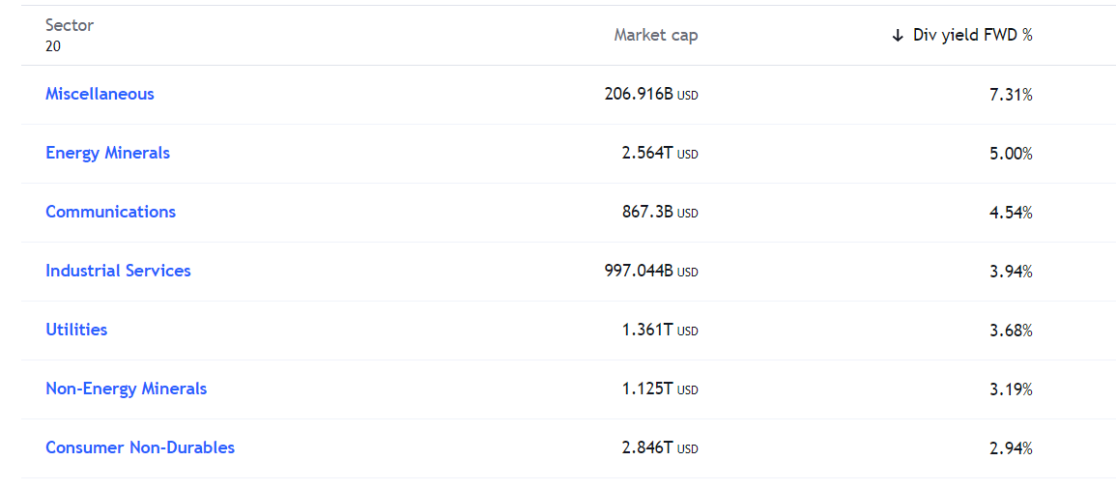
Dividend Yield Portfolio
Source: https://www.tradingview.com/markets/stocks-usa/sectorandindustry-sector/

Slide 3
Selection Criteria
P/E < 30
Market Capital > $US 10 Billion
Div Yield % > 7%

Slide 4
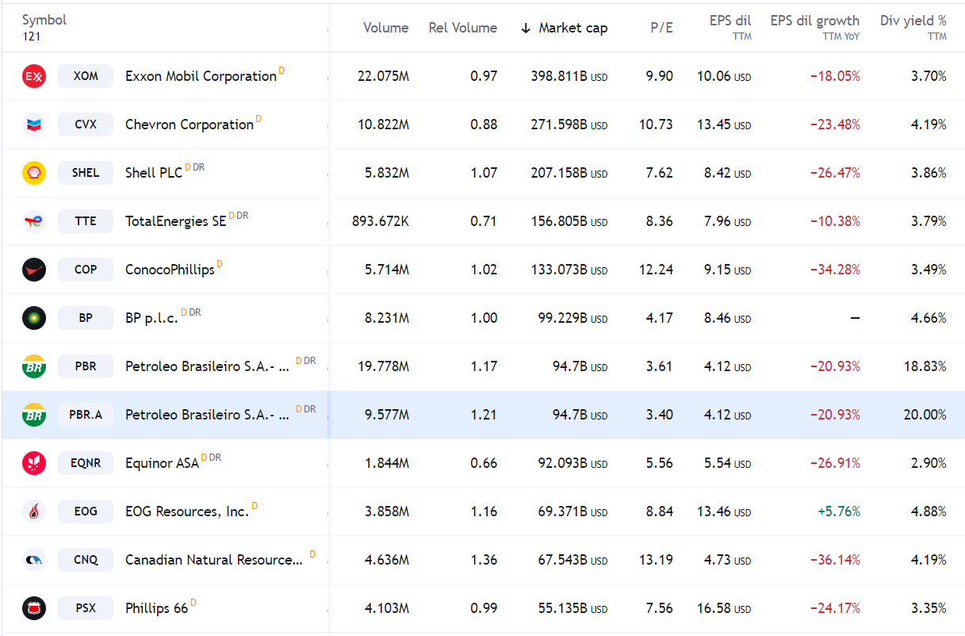
Energy Mineral

Slide 5
SWOT for Petroleo Brasileiro S.A.- Petrobras

Slide 6
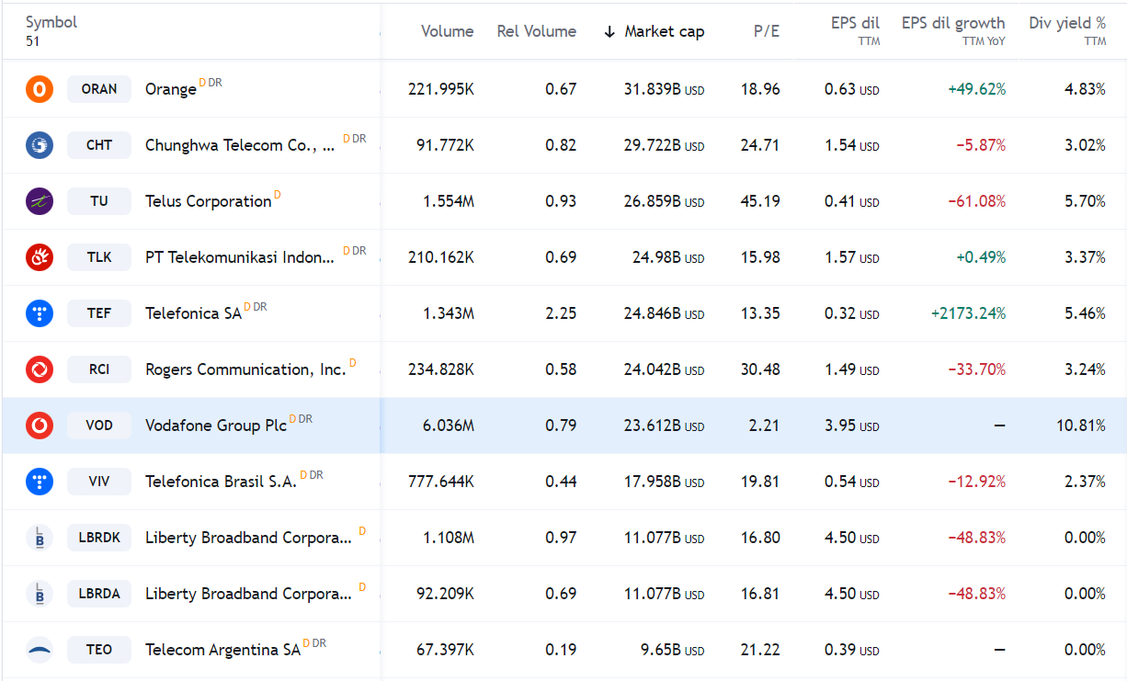
Communications

Slide 7
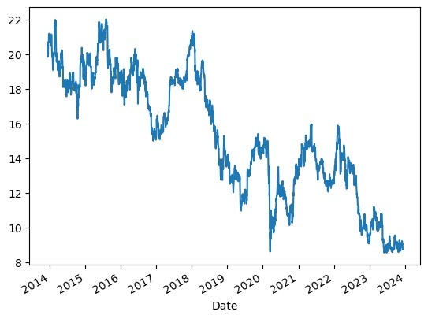
Problem with Vodafone

Slide 8
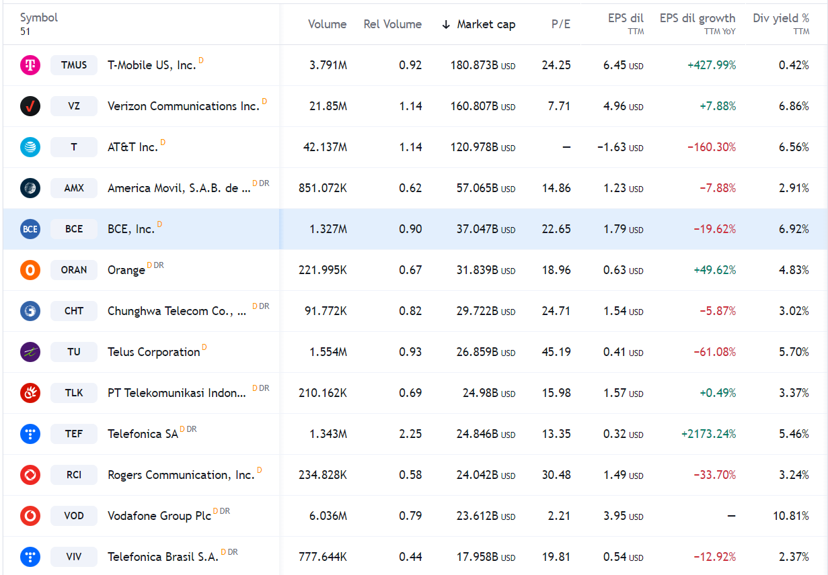
Communication

Slide 9
SWOT for BCE, Inc.

Slide 10
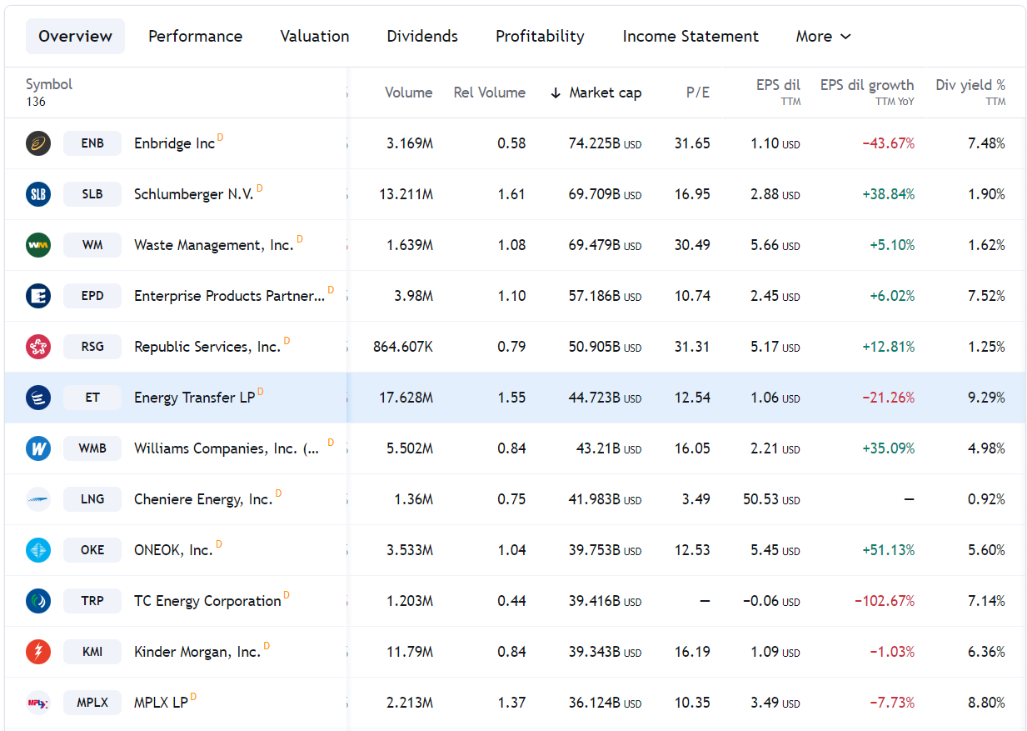
Industrial Service

Slide 11
SWOT for Energy Transfer LP

Slide 12
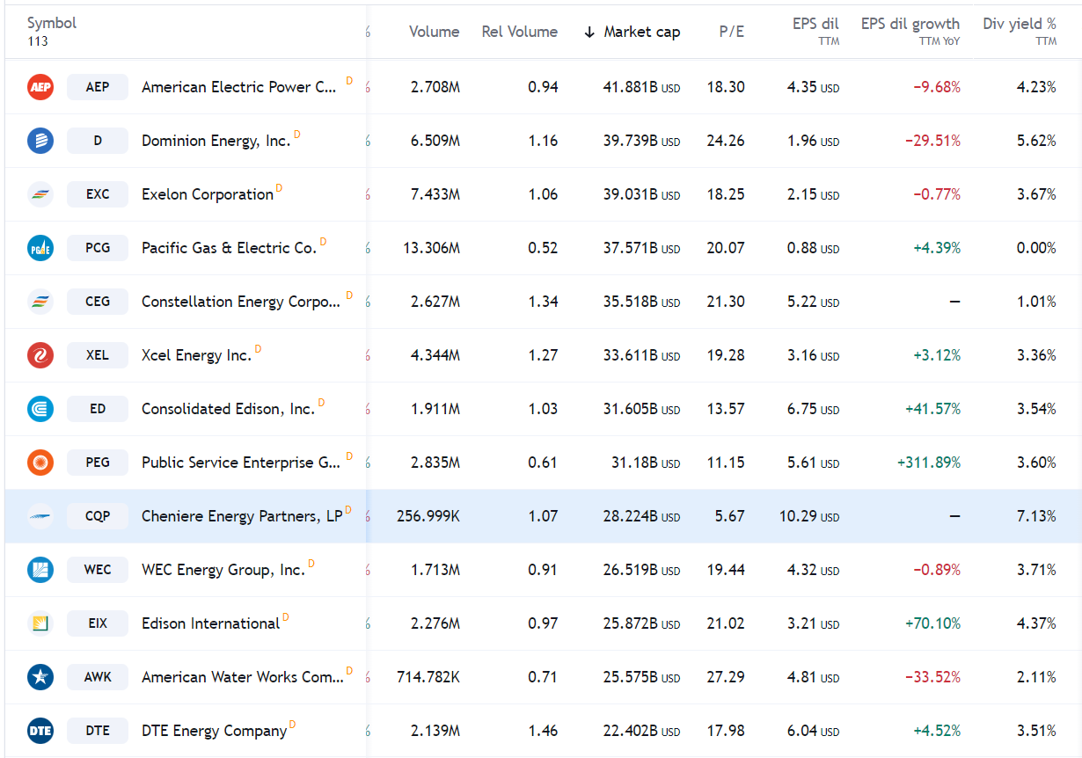
Utilities

Slide 13
SWOT for Cheniere Energy Partners, LP

Slide 14
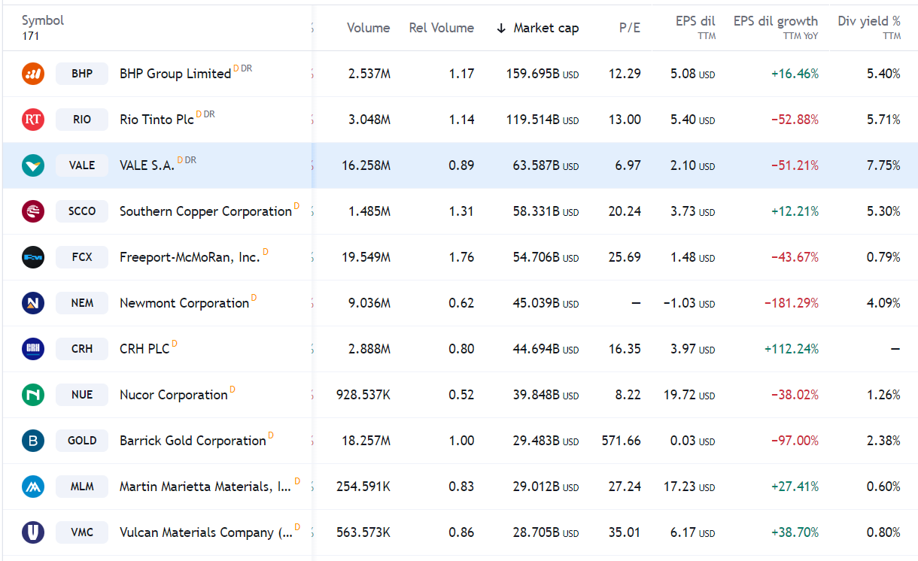
Non-Energy Minerals

Slide 15
SWOT for Vale S.A.

Slide 16
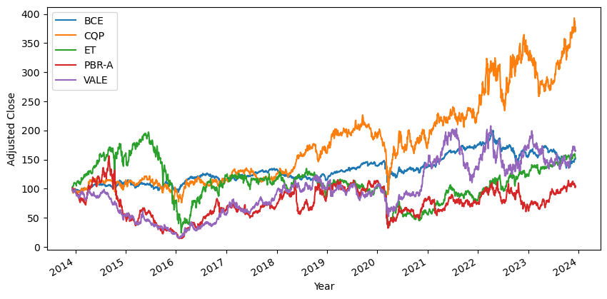
Plot comparing Adjusted Close Price

Slide 17
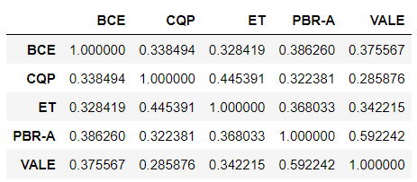
Log Return Correlation

Slide 18
Optimal Weights Using Sharpe Ratio
Sector | Company | Ticker | Div_yeild_% | Optimal_Weight | Amount_to_Invest_($)
Energy Minerals | Petroleo Brasileiro S.A.- Petrobras | PBR-A | 20 | 0.018714 | 1871.4
Communication | BCE, Inc. | BCE | 6.92 | 0.299971 | 29997.1
Industrial Services | Energy Transfer LP | ET | 9.16 | 0.084176 | 8417.6
Utilities | Cheniere Energy Partners, LP | CQP | 7.17 | 0.581577 | 58157.7
Non-Energy Minerals | Vale S.A. | VALE | 7.75 | 0.015562 | 1556.2
 |  |  |  | Total = 1 | Total = 100000

Slide 19
Stock Prices after 10 Years
Method Used: Monte Carlo Simulation
Sector | Company | Ticker | Current_Stock _Price | Stock_Price_after_10_years | Sock_price_Change | %Change_in_Stock_Price
Energy Minerals | Petroleo Brasileiro S.A.- Petrobras | PBR-A | 14.01 | 27.82 | 13.81 | 98.57244825
Communication | BCE, Inc. | BCE | 40.61 | 48.09 | 7.48 | 18.41910859
Industrial Services | Energy Transfer LP | ET | 13.33 | 15.59 | 2.26 | 16.95423856
Utilities | Cheniere Energy Partners, LP | CQP | 59.3 | 104.46 | 45.16 | 76.15514334
Non-Energy Minerals | Vale S.A. | VALE | 14.68 | 31.09 | 16.41 | 111.7847411

Slide 20
Thank You

